Slide 1
Admin Screens flowchart
Splash screen
NO
First time setup
Yes
Installation Location (local or AWS selection)
Local or AWS
Local Network installation screen (enter company name select network folder)
AWS installation (enter MC #, company name, setup database)
Enter user name and password
User setup screen (main configuration screen)

Slide 2
User setup screen (main configuration screen)
Tab selection
Users
Email Setup
Add New User clicked go to screen 2
Email Send Successfully if successfully when Send test email button is clicked
Edit User Screen go to screen 3
Remove User (When remove button is clicked)
Warning Box
Are you sure you want to remove user from the database.

Slide 3



Users
Email Setup
Screen 1
Add
Edit
Remove
Current Users
Selected User Profile
User Name
First Name
M.I.
Last Name
Job Title
Phone number
Extension
Cell Phone
E-mail
Software Permission
Modules | Access
Accounting | No Access
Accident Register | Read Only
Contacts | Read/Write
Dispatch | Read/Write
Driver | Read
IFTA/Fuel | Read
Maintenance | Read/Write
NOTE:
User name table will show all active users in the database.
When user is selected, profile and fields will be automatically populated with information. User profile can be edited by double-click on the user name or single-click on the Edit icon at the top of the screen.
Remove button will remove user from the database. A warning box will popup asking “Are you sure you want to remove user?” and it will have Yes and Cancel options.
Add button will open add user screen to add new user to the database

Slide 4


Add User
Screen 2
Save
Close
Add New User
First Name
Last Name
Job Title
Office Phone
Extension
Fax Number
Cell Phone
E-mail

Slide 5
Edit User
Screen 3
Save Changes
Close
Edit User
First Name
Last Name
Job Title
Office Phone
Extension
Fax Number
Cell Phone
E-mail

Slide 6
Users
Email Setup
Screen 4
Email Settings
Incoming email server
port
outgoing email server
port
Send From Email
Send TO Email
Confirm Email
Connection
NOTE:
Admin will be able to test email connection with test email addresses provided.
Email subject = BH Innovation Test Connection
Email Content = Your email has been setup successfully.

Slide 7
Client Screens flowchart
Splash screen
Main Screen (defaulted to home tab)
Screen Tab selection
Home Tab
Accounting
Accident Register
Contacts
Dispatch
Drivers
IFTA
Maintenance

Slide 8
Client Screens flowchart
Home Tab
Settings clicked go to screen 6
Company clicked go to screen 9
Database Tab
Accounting Setup
Fuel Setup Tab (Screen 8)
Local Network
AWS Database
Show Msg. Box (Is QuickBooks isled on this computer?)
No Accounting Setup Required (Return to Database tab)
Show Accounting Tab
Custom Fields go to screen 10
Payroll go to screen 12
Class go to screen 11

Slide 9


HOME
Accounting
Accident Register
Contacts
Dispatch
Drivers
IFTA/Fuel
Maintenance
Reports
Screen 5
Settings
Company
Driver CDL Expirations
Truck IRP, DOT inspection, and Registration Due Dates
Driver Name | Expiration Date
Truck Number | IRP Due Date | DOT Inspection Due Date | Registration Due Date
Driver Medical Certificate Expirations
Truck Upcoming Maintenance Inspections
Driver Name | Expiration Date
Truck Number | Inspection Due Date | Inspection Description

Slide 10


Database Setup
Accounting Setup
Fuel Setup
Local Network
Screen 6
AWS Database
Local Network (only shows when local network is selected)
Select Database Network Location
Test
Connection
AWS Database (only shows when AWS database is selected)
Host Name
Test
Connection
Port Number
Opens Standard windows file dialog window
NOTE: When test connection button is clicked user will get notified if connection is successful or if connection to database failed

Slide 11


Database Setup
Accounting Setup
Fuel Setup
Screen 7
Import
Customers
Setup
Custom Fields
Setup
Payroll
Setup
Classes
Select QuickBooks Company File
Select Database Network Location
Test
Connection
Opens Standard windows file dialog window

Slide 12

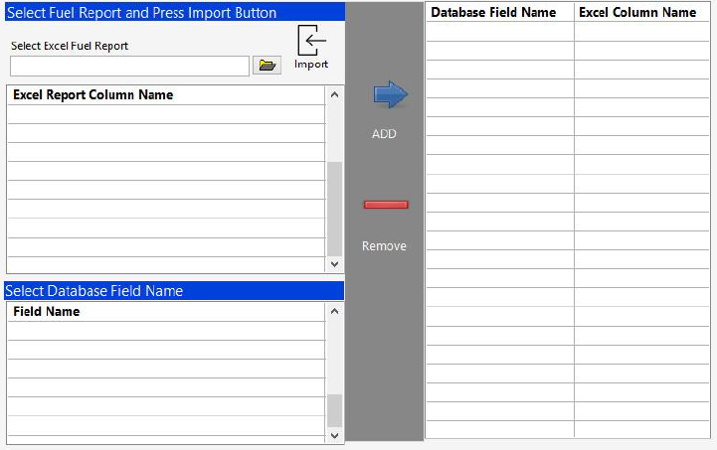
Database Setup
Accounting Setup
Fuel Setup
Options are below:
FleetOne
CommDate
TCH
Pilot
Screen 8
Select Fuel Provider
Opens Standard windows file dialog window

Slide 13



Screen 9
Save
Add
Document
View
Documents
Close
Company Profile
Full Name
Dot Number
Dot Number
Oregon Tex ID
Dot Number
Street Address Number and Name
MC Number
Dot Number
KYU Number
Dot Number
City
State
Zip Code
EIN/Fed ID
Dot Number
Phone Number
Fax Number
IFTA Number
Dot Number
Main Company Email
New Mexico ID
Dot Number
Cargo Insurance
Liability Insurance
Cargo Insurance Company Name
Auto Liability Insurance Company Name
Street Address Number and Name
Street Address Number and Name
City
State
Zip Code
City
State
Zip Code
Phone Number
Fax Number
Phone Number
Fax Number
Policy Number
Expiration Date
Policy Number
Expiration Date
Agent Name
Agent Name
Agent Phone Number
Agent Phone Number

Slide 14
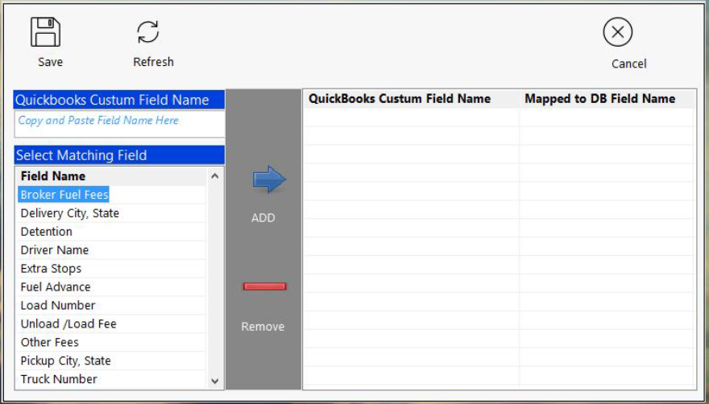
QuickBooks custom field setup
Screen 10

Slide 15
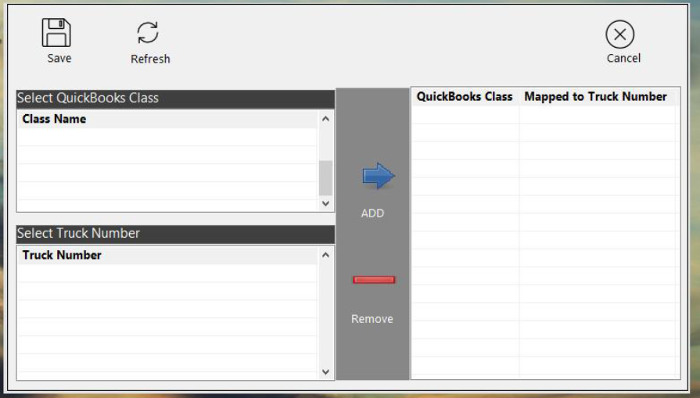
QuickBooks Class Setup
Screen 11

Slide 16
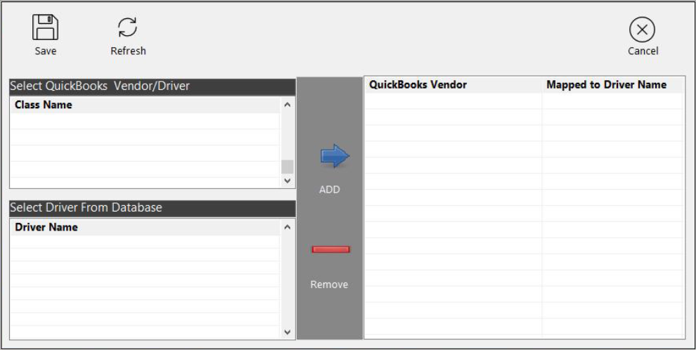
QuickBooks Vendor/Driver Setup
Screen 12

Slide 17
Client Screens flowchart
Accounting Tab
Overview Selected
Invoicing Selected
Company clicked go to screen 9
Screen 13
Screen 14
Screen 15

Slide 18
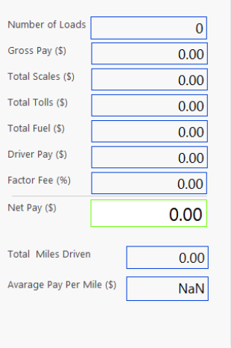
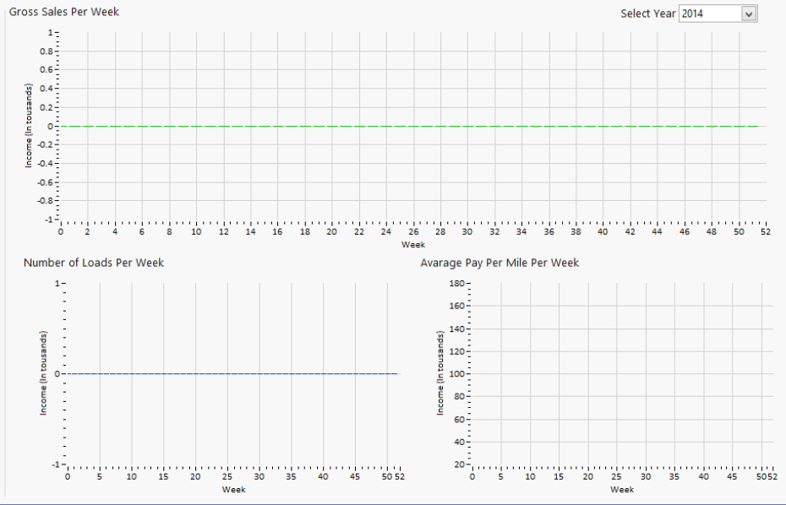
HOME
Accounting
Accident Register
Contacts
Dispatch
Drivers
IFTA/Fuel
Maintenance
Reports
Overview
Selection are
Overview
Invoicing
Payroll
Screen 13

Slide 19


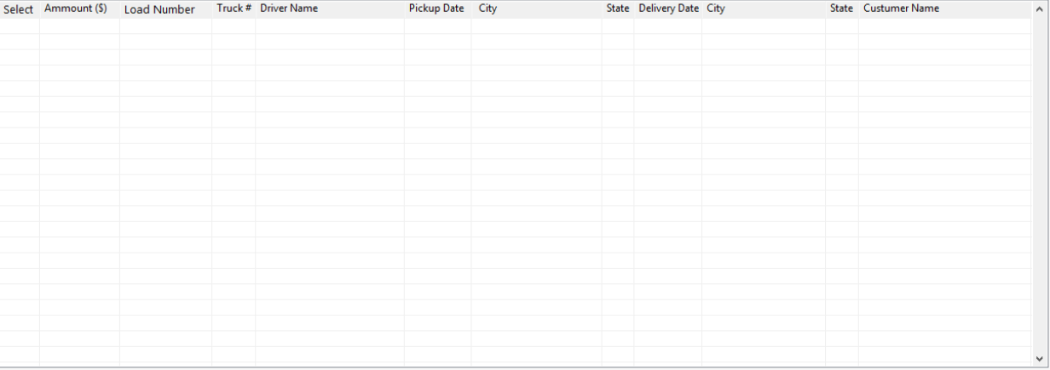
HOME
Accounting
Accident Register
Contacts
Dispatch
Drivers
IFTA/Fuel
Maintenance
Reports
Invoicing
Load Status
QB Invoice Template
Invoice Line Description
from
Filter Criteria
Job Type
Invoice Date
Load
Expenses
Save Selected
To QB
Export
to
Filter Value
Invoice Item List
Use QB Classes
Select Loads to Invoice
Payment Terms
Save Invoice to QB Print
Screen 14

Slide 20

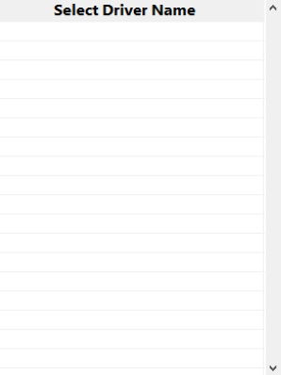
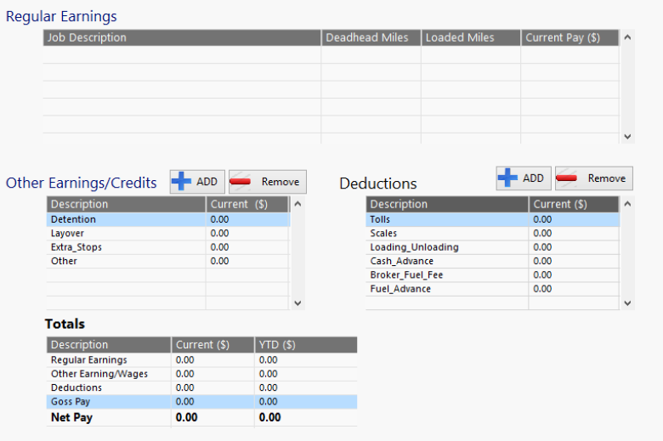
HOME
Accounting
Accident Register
Contacts
Dispatch
Drivers
IFTA/Fuel
Maintenance
Reports
Payroll
Pay Period
Pay Date
Screen 15
from
Date
Save Selected
To QB
Print
Paystub
to

Slide 21
Client Screens flowchart
Accident Register Tab
New Record
Add document
View Document
Export
Screen 17
Screen 18
Windows File Selection window
Export table into excel
Screen 18

Slide 22

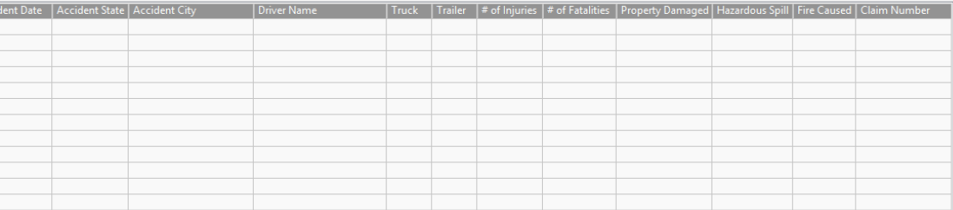
HOME
Accounting
Accident Register
Contacts
Dispatch
Drivers
IFTA/Fuel
Maintenance
Reports
from
Screen 16
New
Record
Add
Document
View
Document
Export
to

Slide 23
Screen 17
Save
Close
Add Record to Accident Register
Accident Date
City
State
Driver Name
Truck Number
Trailer Number
# of Injuries
# of Fatalities
Property Damaged
Hazardous Spill
Fire Caused
Insurance Claim Number

Slide 24
Screen 18
Save
Close
Select or Enter Claim
Select Claim
New Claim Number

Slide 25
Client Screens flowchart
Contacts Tab
Costumer Contacts
Costumer
Add
Edit
Add
Edit
Screen 22
Screen 23
Screen 20
Screen 21

Slide 26

HOME
Accounting
Accident Register
Contacts
Dispatch
Drivers
IFTA/Fuel
Maintenance
Reports
Costumer Contacts
Costumer
Search By:
Add
Edit
Remove
Search Value
Add
Edit
Remove
Screen 19
Costumer Name
Active Contacts
Selected Contact Information
First Name
Last Name
Job Title
Office Phone
Extension
Fax Number
Cell Phone
E-mail
Costumer Billing Address
Name
Street Address Number and Name
P.O. BOX
City
State
Zip Code
Phone
Fax
Email
Costumer Ship Address
Name
Street Address Number and Name
P.O. BOX
City
State
Zip Code

Slide 27
Add New Costumer
Screen 20
Save
Add File
Close
Costumer Billing To Address (QuickBooks Bill To: Address)
Name
Street Address Number and Name
P.O. BOX
City
State
Zip Code
Phone
Fax
Email
Federal ID
MC Number
Costumer Shipping Address (QuickBooks Shipp To: Address)
Save as above
Name
Street Address Number and Name
P.O. BOX
City
State
Zip Code
Notes

Slide 28
Edit Costumer
Screen 21
Save Changes
Add File
Close
Costumer Billing To Address (QuickBooks Bill To: Address)
Name
Street Address Number and Name
P.O. BOX
City
State
Zip Code
Phone
Fax
Email
Federal ID
MC Number
Costumer Shipping Address (QuickBooks Shipp To: Address)
Save as above
Name
Street Address Number and Name
P.O. BOX
City
State
Zip Code
Notes

Slide 29
Add New Contact
Screen 22
Save
Close
Select Company and add new contact
Select Company
First Name
Last Name
Job Title
Office Phone
Extension
Fax Number
Cell Phone
E-mail

Slide 30
Edit Contact
Screen 23
Save Changes
Close
Select Company and add new contact
First Name
Last Name
Job Title
Office Phone
Extension
Fax Number
Cell Phone
E-mail

Slide 31
Client Screens flowchart
Dispatch Tab
Load Boards
Availability
Calendar
Map
Screen 24
Screen 32
Screen 33
Screen 34
Add go to Screen 25
Edit go to Screen 25
Check Call go to Screen 27
Email Broker go to Screen 28
Email Driver go to Screen 29
Text Driver go to Screen 30
Load Expenses go to Screen 31
Favorites go to Screen 26
Export, export table to excel sheet
Map go to Screen 34

Slide 32










HOME
Accounting
Accident Register
Contacts
Dispatch
Drivers
IFTA/Fuel
Maintenance
Reports
Load Board
Availability
Calendar
Map
Date Range
Load Filtering
Add
Edit
Favorite
from
to
Check
Call
Email
Broker
Email
Driver
Text
Driver
Load
Expenses
Export
Map
Load
Select First Criteria
AND
Select Second Criteria
First Criteria Value
Second Criteria Value
from
Delete
Add
Stop
Remove
Stop
to
Search
Load Editing
Costumer Update
Driver Update
Accounting
Costumer Update
Screen 24

Slide 33

Add/Edit Load
Dispatcher Name
Screen 25
Save
Close
Enter New Load Information
Load Number
Load Type
Load Status
Equipment Type
Select Costumer
Driver 1
Driver 2
Truck #
Trailer #
Select Contact
Pickup Location
Delivery Location
Payment
Pickup Date
Pickup Number
Pickup Date
Pickup Number
Gross Pay (USD)
Company Name
Company Name
Street Address
Street Address
City
State
City
State
Zip Code
Zip Code
Dispatcher Notes
Send Information to Driver
Enter Notes
Load Number
Pickup Location
Email
Delivery Location
SMS
Dispatcher Notes
Test Message

Slide 34
Favorites
Load Favorite List (Double Click to Select)
Screen 26
Close
Pickup Address | Pickup City | Pickup State | Delivery Address | Delivery City | Delivery State | Broker/Costumer Name | Costumer Contact

Slide 35
Check Call
Dispatcher Name
Save
Email
Close
Screen 27
Current Location
Load Number
Load #
Date
Time
City
State
Zip Code
Dispatcher Notes

Slide 36
Email Broker
TO:
Importance
CC:
Normal
Send
Close
Subject:
Attachments:
Screen 28
Email Body

Slide 37
Email Driver
Driver
Importance
Email:
Normal
Send
Close
Subject:
Screen 29
Attachments:
Email Body

Slide 38
Send Driver Text Message
SMS
Driver
Select Driver
Carrier
Select Phone Carrier
Close
Send
Number
Phone Number
Screen 30
Type Text Message

Slide 39
Load Expenses
SMS
Driver Name
Send
Close
Load Information
Screen 31
Load Number
Number
Deadhead Miles
Number
Gross Pay
Number
Loaded Miles
Number
Expenses
Advances
Driver Pay
Number
Detention
Number
Tolls
Number
Layover
Number
Scales
Number
Extra Stops
Number
Load/Unload
Number
Other
Number
Cash Advance
Number
Fuel Advance
Number
Fuel Fees
Number
Other
Number

Slide 40
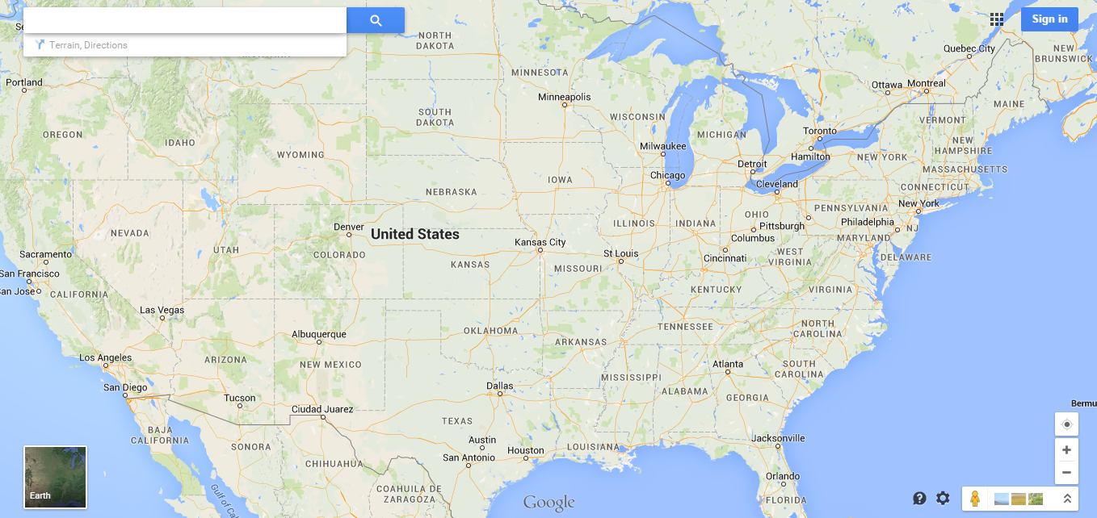
HOME
Accounting
Accident Register
Contacts
Dispatch
Drivers
IFTA/Fuel
Maintenance
Reports
Load Board
Availability
Calendar
Map
Trucks
Drivers
Trailers
Screen 32
Email
Board
Show on Map
Truck Number | Location (City, State)
Trailer Number | Location (City, State)
Driver Name | Phone Number

Slide 41
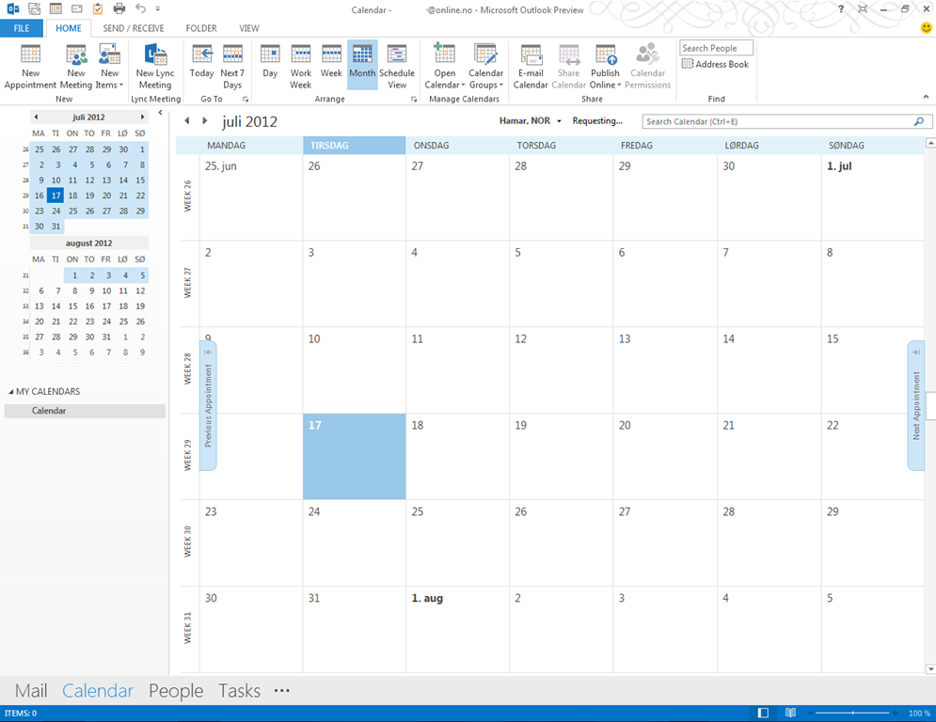
HOME
Accounting
Accident Register
Contacts
Dispatch
Drivers
IFTA/Fuel
Maintenance
Reports
Load Board
Availability
Calendar
Map
Screen 33
Email
Board
Truck 100
Truck 105
Truck 169
Truck 205

Slide 42

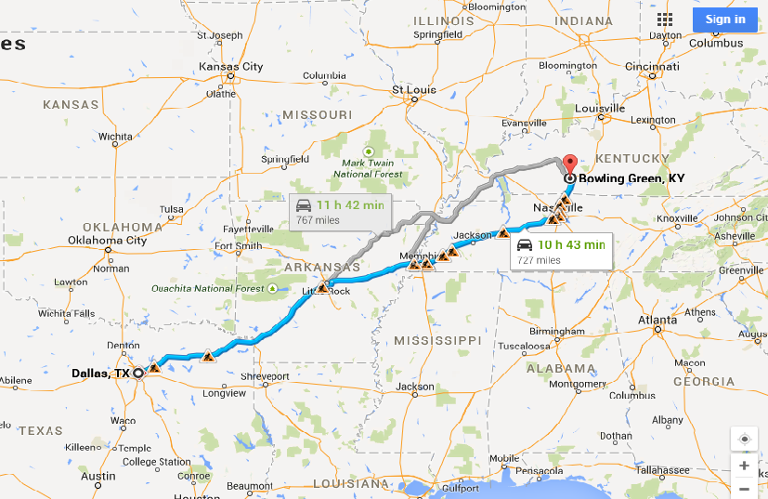
HOME
Accounting
Accident Register
Contacts
Dispatch
Drivers
IFTA/Fuel
Maintenance
Reports
Load Board
Availability
Calendar
Map
Trip Miles
Trip Time
Fuel Cost
Toll Charges
IFTA
Driver Pay
Profit
Run Trip
Trip Route
Address 1 (Address or Zip Code)
Screen 34
Address 2 (Address or Zip Code)
Address 3 (Address or Zip Code)
Address 4 (Address or Zip Code)
Address 5 (Address or Zip Code)
Address 6 (Address or Zip Code)
Address 7 (Address or Zip Code)
Address 8 (Address or Zip Code)
Address 9 (Address or Zip Code)
Address 10 (Address or Zip Code)

Slide 43
Client Screens flowchart
Drivers Tab
Add go to
Screen 36
Edit go to Screen 37
View go to
Screen 38
Export
Export table to
excel sheet

Slide 44
HOME
Accounting
Accident Register
Contacts
Dispatch
Drivers
IFTA/Fuel
Maintenance
Reports
Active
from
Search Driver
Add
Edit
View
Export
to
Driver Name | CDL Exp. Date | Medical Exp. Date
Screen 35

Slide 45
Add New Driver
Screen 36
Save
Add File
Close
Driver Personal Profile
First Name
Middle Name
Last Name
SSN
CDL Number
Street Address Number and Name
City
State
Zip Code
CDL Status
Cell Phone Number
Cell Carrier
Email
CDL Expiration Date
Emergency Contact Name
Emergency Contact Phone
CDL Issuing State
Driver Company Profile
CDL Violation
Date of Hire
Last Alcohol Test Date
Assigned Truck
Date | Violation Number | Violation Description
Hire Status
Last Drug Test Date
Assigned Trailer
Classification
Fuel Card ID
Pay Type
Fuel Card Number
Pay Rate
Pay Rate Empty Miles
Notes

Slide 46
Edit Driver Profile
Search
Screen 37
Save Changes
Add File
Close
Driver Personal Profile
First Name
Middle Name
Last Name
SSN
CDL Number
Street Address Number and Name
City
State
Zip Code
CDL Status
Cell Phone Number
Cell Carrier
Email
CDL Expiration Date
Emergency Contact Name
Emergency Contact Phone
CDL Issuing State
Driver Company Profile
DOT Inspections
Date of Hire
Last Alcohol Test Date
Assigned Truck
Date | Inspection Number | Inspection Description
Hire Status
Last Drug Test Date
Assigned Trailer
Classification
Fuel Card ID
Pay Type
Fuel Card Number
Pay Rate
Pay Rate Empty Miles
Notes

Slide 47
View Driver Profile
Search
Screen 38
Save Changes
Add File
Close
Driver Personal Profile
First Name
Middle Name
Last Name
SSN
CDL Number
Street Address Number and Name
City
State
Zip Code
CDL Status
Cell Phone Number
Cell Carrier
Email
CDL Expiration Date
Emergency Contact Name
Emergency Contact Phone
CDL Issuing State
Driver Company Profile
DOT Inspections
Date of Hire
Last Alcohol Test Date
Assigned Truck
Date | Inspection Number | Inspection Description
Hire Status
Last Drug Test Date
Assigned Trailer
Classification
Fuel Card ID
Pay Type
Fuel Card Number
Pay Rate
Pay Rate Empty Miles
Notes

Slide 48
Client Screens flowchart
IFTA Tab
Add Fuel Manually go to Screen 40

Slide 49

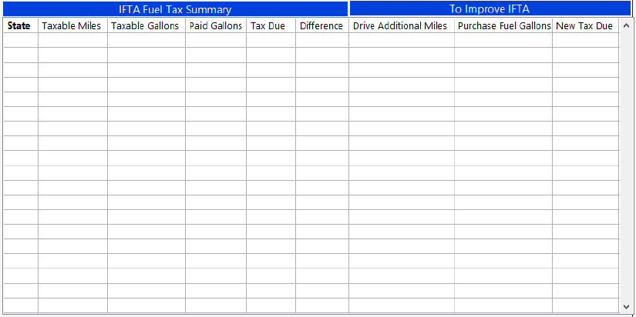
HOME
Accounting
Accident Register
Contacts
Dispatch
Drivers
IFTA/Fuel
Maintenance
Reports
Select
Date Range
from
Screen 38
Import
Fuel
Add Fuel
Manually
Edit Fuel
Entry
Download
IFTA Rates
to
Select Truck Number
Truck Number

Slide 50
Screen 40
Save
Close
Add Fuel
Select Fuel Provider
Date
City
State
Select Truck
Select Fuel Type
Amount in Gallons
Total Price

Slide 51
Client Screens flowchart
Maintenance Tab
Trucks Selected go to Screen 41
Trailers Selected go to Screen 42
Add go to
Screen 43
New Inspection go to
Screen 49
Add go to
Screen 46
New Inspection go to
Screen 49
Edit go to
Screen 44
New Record go to
Screen 50
Edit go to
Screen 47
New Record go to
Screen 50
view go to
Screen 45
Export
Export table to excel
view go to
Screen 48
Export
Export table to excel

Slide 52
HOME
Accounting
Accident Register
Contacts
Dispatch
Drivers
IFTA/Fuel
Maintenance
Reports
Active
Search
from
Trucks
Add
Edit
View
New Inspection
New Record
Export
to
Truck Number | IRP Due Date | DOT Inspection Date | Next Maintenance Inspection Due | Inspection Type
These boxes represent ribbon group
Screen 41

Slide 53
HOME
Accounting
Accident Register
Contacts
Dispatch
Drivers
IFTA/Fuel
Maintenance
Reports
Active
Search
from
Trailers
Add
Edit
View
New Inspection
New Record
Export
to
Trailer Number | Registration Due Date | DOT Inspection Date | Next Maintenance Inspection Due | Inspection Type
Screen 42

Slide 54
Add New Truck
Screen 43
Save
Add File
Close
Truck Identification
Truck Number
Make
Model
Year
VIN Number
Title Number
IRP Number
IRP Exp. Date
State of Registration
Ownership
License Plate
Plate Exp. Date
Classification
Owner Name
Truck Statistics
Truck Physical Damage Insurance
Height (ft)
# of Axles
Purchase Price
Tire Size
Insurance Name
Inspection Date
Policy Number
Exp. Date
Add Truck Maintenance Records
Add Record
Date | Description of Maintenance | Odometer Reading | Inspection/Maintenance Type | Scheduled Maintenance | Maintenance Shop | Invoice Number

Slide 55
Edit Truck Profile
Search
Screen 44
Save Changes
Add File
Close
Truck Identification
Truck Number
Make
Model
Year
VIN Number
Title Number
IRP Number
IRP Exp. Date
State of Registration
Ownership
License Plate
Plate Exp. Date
Classification
Owner Name
Truck Statistics
Truck Physical Damage Insurance
Height (ft)
# of Axles
Purchase Price
Tire Size
Insurance Name
Inspection Date
Policy Number
Exp. Date
Add Truck Maintenance Records
From date
Add Record
Export
To date
Date | Description of Maintenance | Odometer Reading | Inspection/Maintenance Type | Scheduled Maintenance | Maintenance Shop | Invoice Number

Slide 56
View Truck Profile
Search
Screen 45
Edit Profile
Add File
Close
Truck Identification
Truck Number
Make
Model
Year
VIN Number
Title Number
IRP Number
IRP Exp. Date
State of Registration
Ownership
License Plate
Plate Exp. Date
Classification
Owner Name
Truck Statistics
Truck Physical Damage Insurance
Height (ft)
# of Axles
Purchase Price
Tire Size
Insurance Name
Inspection Date
Policy Number
Exp. Date
Add Truck Maintenance Records
From date
Add Record
Export
To date
Date | Description of Maintenance | Odometer Reading | Inspection/Maintenance Type | Scheduled Maintenance | Maintenance Shop | Invoice Number

Slide 57
Add New Trailer
Screen 46
Save
Add File
Close
Trailer Identification
Trailer Number
Make
Model
Year
VIN Number
Title Number
License Plate
Plate Exp. Date
State of Registration
Ownership
Classification
Owner Name
Trailer Statistics
Trailer Physical Damage Insurance
Inspection Date
Tire Size
Insurance Name
Policy Number
Exp. Date
Add Trailer Maintenance Records
Add Record
Date | Description of Maintenance | Odometer Reading | Inspection/Maintenance Type | Scheduled Maintenance | Maintenance Shop | Invoice Number

Slide 58
Edit Trailer Profile
Search
Screen 47
Save Changes
Add File
Close
Trailer Identification
Trailer Number
Make
Model
Year
VIN Number
Title Number
License Plate
Plate Exp. Date
State of Registration
Ownership
Classification
Owner Name
Trailer Statistics
Trailer Physical Damage Insurance
Inspection Date
Tire Size
Insurance Name
Policy Number
Exp. Date
Add Trailer Maintenance Records
Add Record
Date | Description of Maintenance | Odometer Reading | Inspection/Maintenance Type | Scheduled Maintenance | Maintenance Shop | Invoice Number

Slide 59
View Trailer Profile
Search
Screen 48
Edit Profile
Add File
Close
Trailer Identification
Trailer Number
Make
Model
Year
VIN Number
Title Number
License Plate
Plate Exp. Date
State of Registration
Ownership
Classification
Owner Name
Trailer Statistics
Trailer Physical Damage Insurance
Inspection Date
Tire Size
Insurance Name
Policy Number
Exp. Date
Add Trailer Maintenance Records
Add Record
Date | Description of Maintenance | Odometer Reading | Inspection/Maintenance Type | Scheduled Maintenance | Maintenance Shop | Invoice Number

Slide 60
Common screen design for trucks and trailers
Save
Close
Screen 49
Add New Inspections
Inspection Date
Select Inspection Type
Enter other inspection type

Slide 61
Common screen design for trucks and trailers
Screen 50
Save
Close
Add New Maintenance Record
Inspection Date
Description of Maintenance
Select Maintenance Type
Scheduled Maintenance
Maintenance Shop Name
Odometer reading
Invoice Number
Invoice Amount
Company Control #

